Slide 1
Zomato Data Analysis Using Python
Unveiling Restaurant Trends, Customer Preferences, and Pricing Insights Through Data

Slide 2
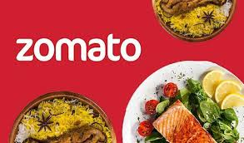
Introduction
Zomato has an average of 17.5 million monthly transacting customers for its food delivery business average monthly active food delivery restaurant partners on Zomato's platform have also increased by 8.7% year-on-year, from 208,000 to 226,000​.You are working in a data-driven role at Zomato. You have a dataset of customers. As a data professional, you need to analyze the data, perform EDA (Exploratory Data Analysis) and visualization.

Slide 3
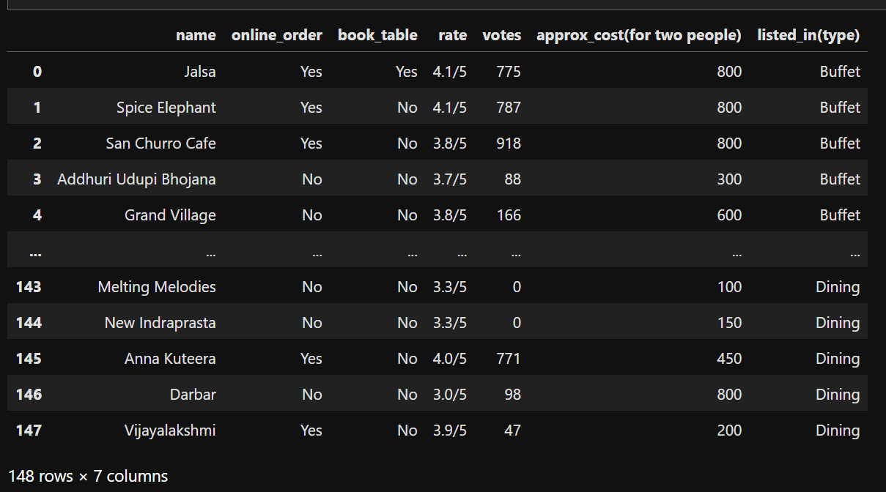
Zomato Dataset

Slide 4
Business Problems
What type of restaurant do the majority of customers order from?
How many votes has each type of restaurant received from customers?
What are the ratings that the majority of restaurants have received?
Zomato has observed that most couples order most of their food online. What is their average spending on each order?
Which mode (online or offline) has received the maximum rating?
Which type of restaurant received more offline orders, so that Zomato can provide those customers with some good offers?

Slide 5
Tools & Technologies Used
Python Libraries: Pandas, NumPy, Matplotlib, Seaborn
Jupyter Notebook
Github

Slide 6
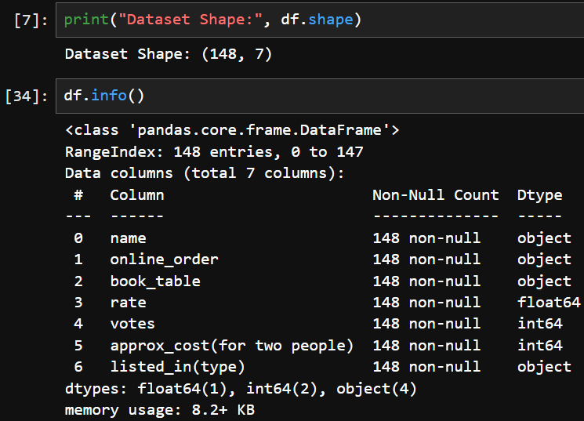
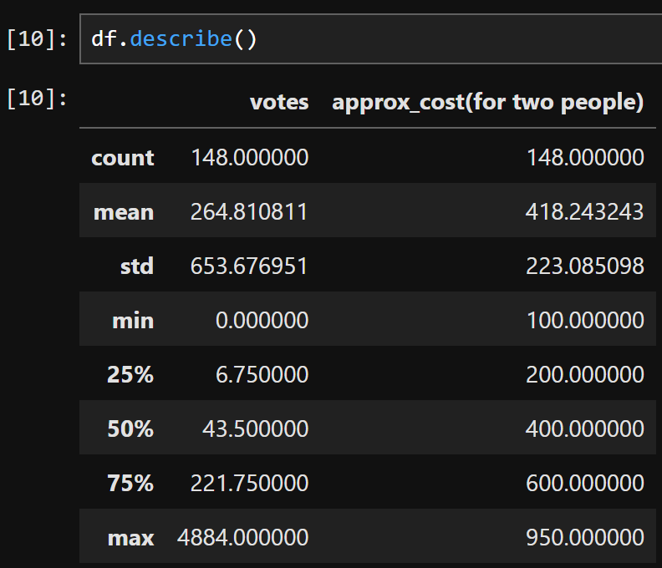
Exploratory Data Analysis (EDA)
Checking dataset shape, info
summary statistics

Slide 7
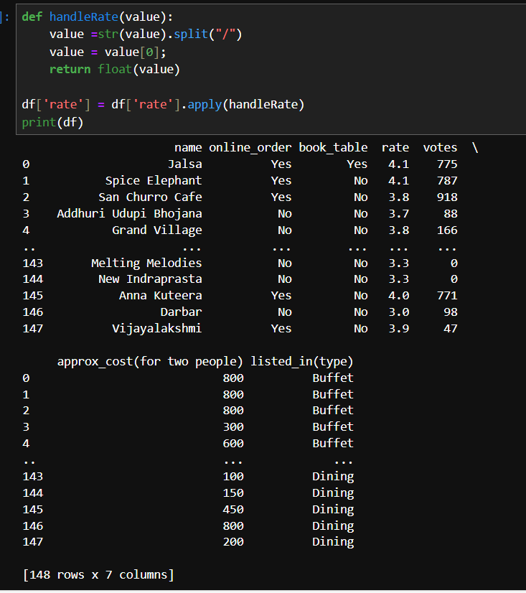
Convert the data type of column - rate

Slide 8
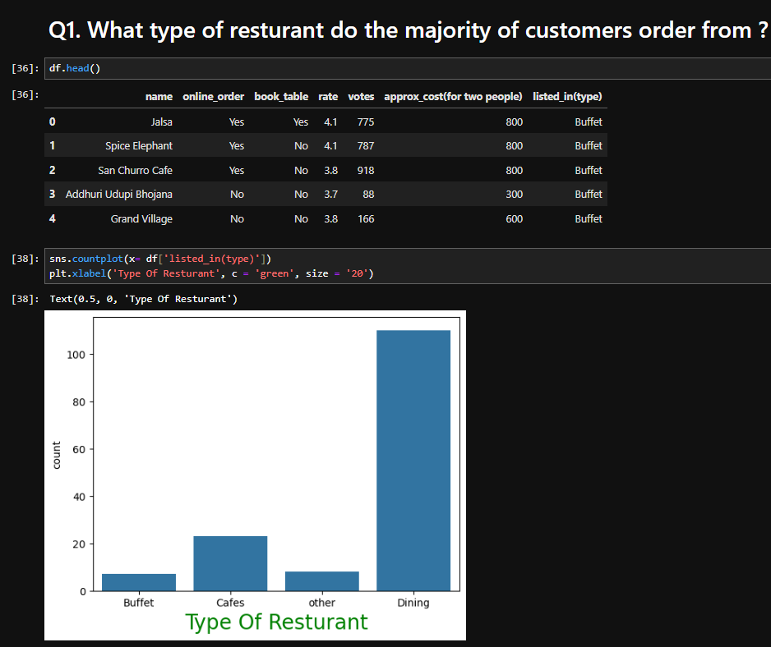
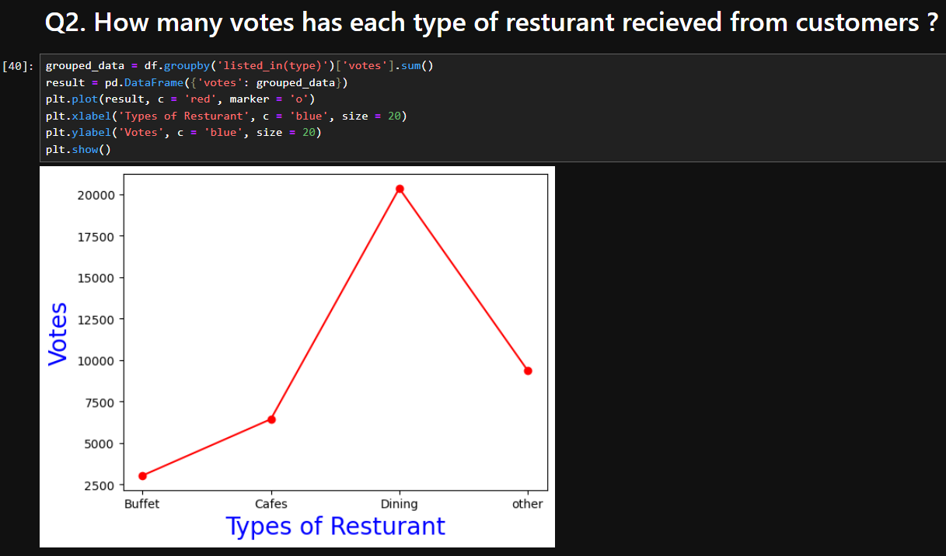
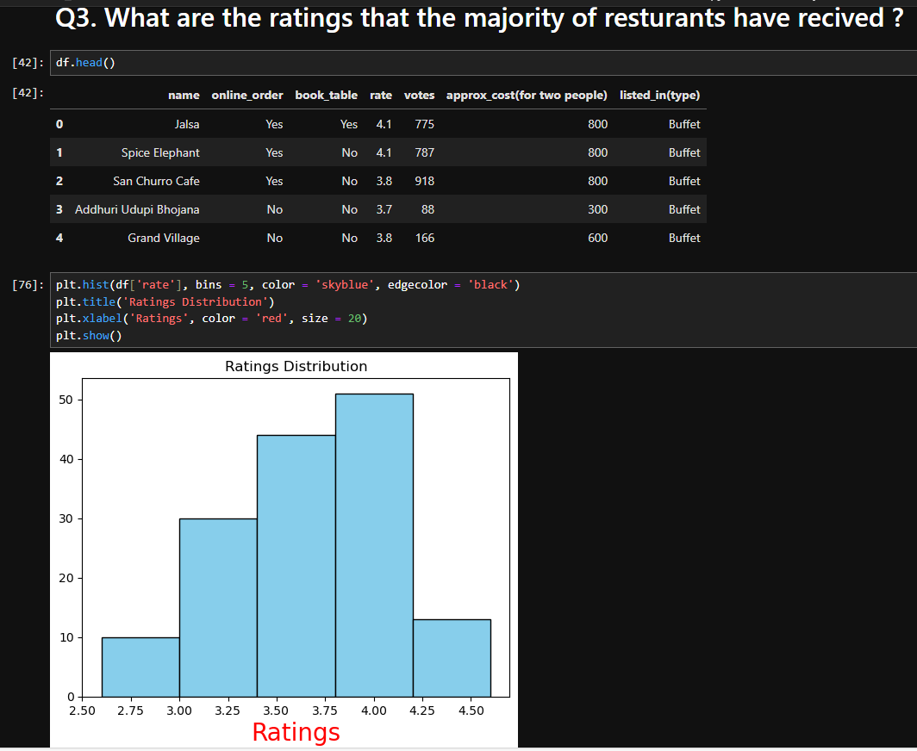
DATA VISUALIZATION (PART-1)

Slide 9
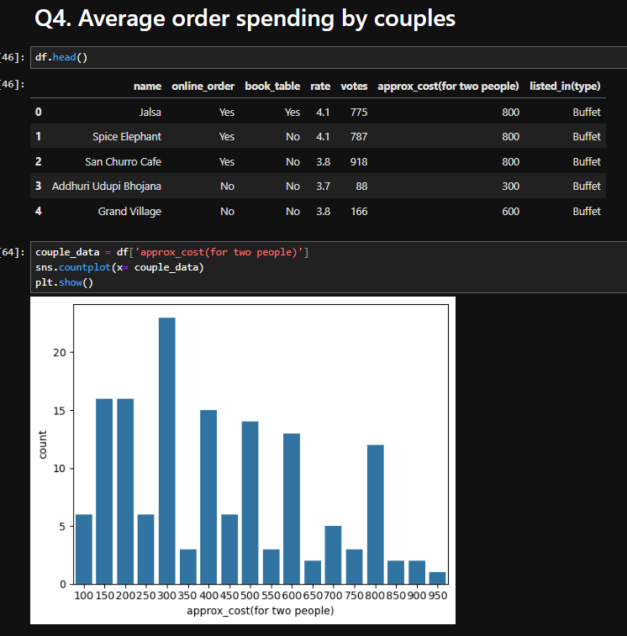
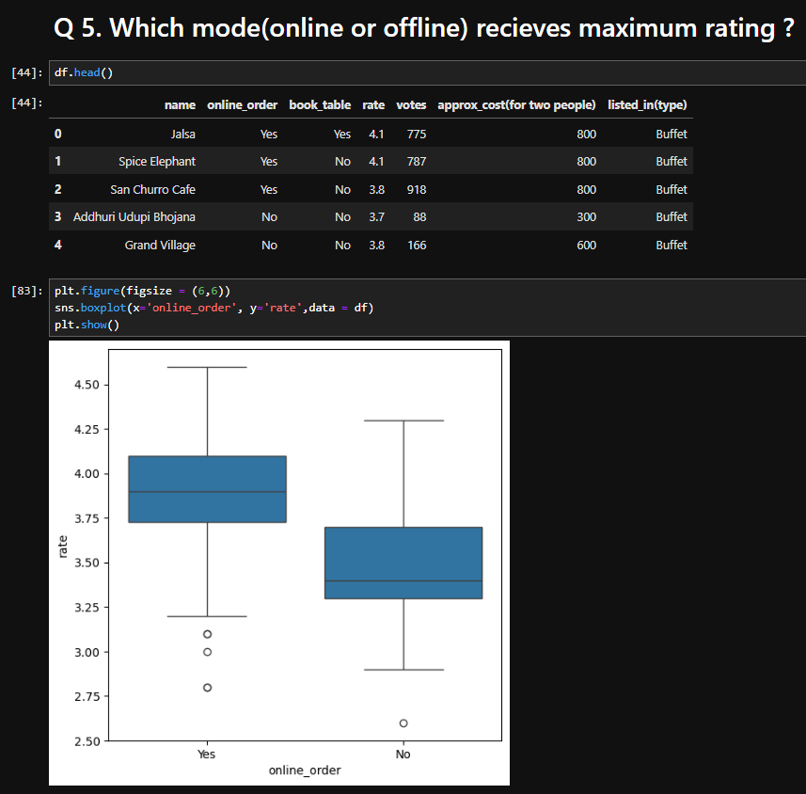
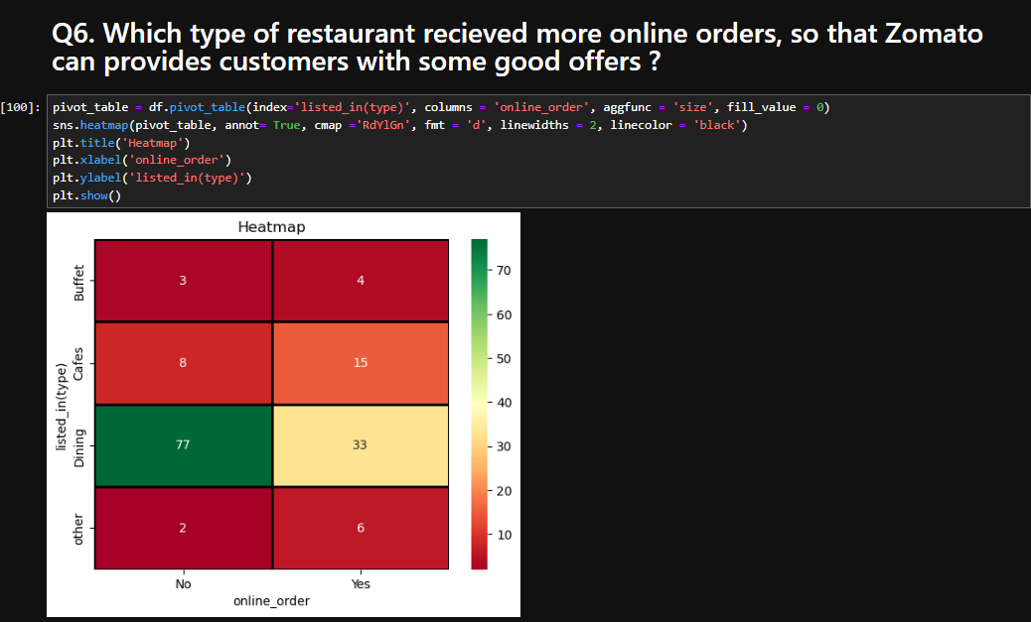
DATA VISUALIZATION (PART-2)

Slide 10
CONCLUSION
majority of the customers falls in dining category.
Dining resturants has received maximum votes from customers.
Majority resturants received ratings from 3.5 to 4
majority of couples prefer restaurants with an approximate cost of 300 rupees.
Offline orders receives lower rating as compared to online orders
Dining resturants primarily accepts offline orders, whereas Cafes primarily accepts online orders. This suggests that clients prefer to place orders in person at resturants, but prefer online ordering at cafes.

